Slide 1
Welcome
Soldering Training 2021

Slide 2
Agenda
Introduction
Board overview - what are we soldering?
How to Solder
Basics
Tools
Component Types
Soldering Instructions
Debugging

Slide 3
Introduction
What is RoboJackets?

Slide 4
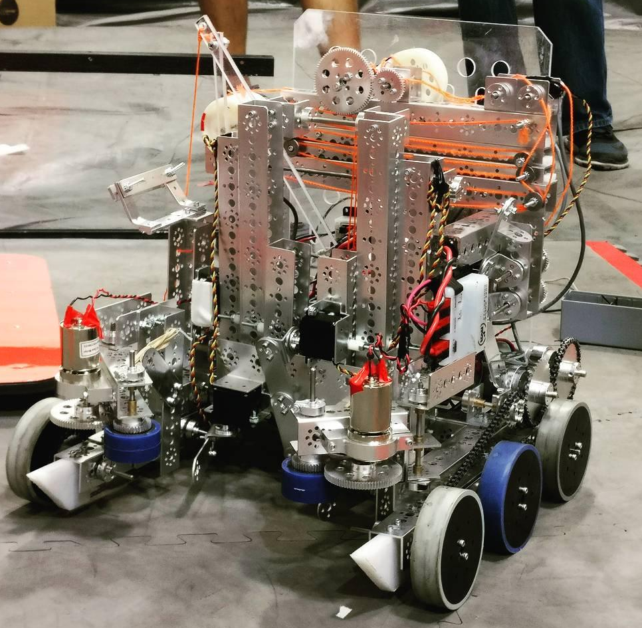
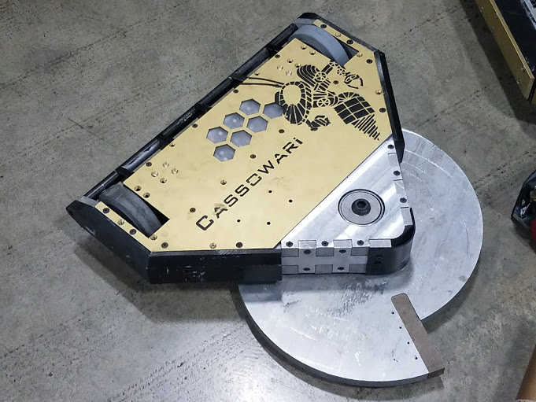
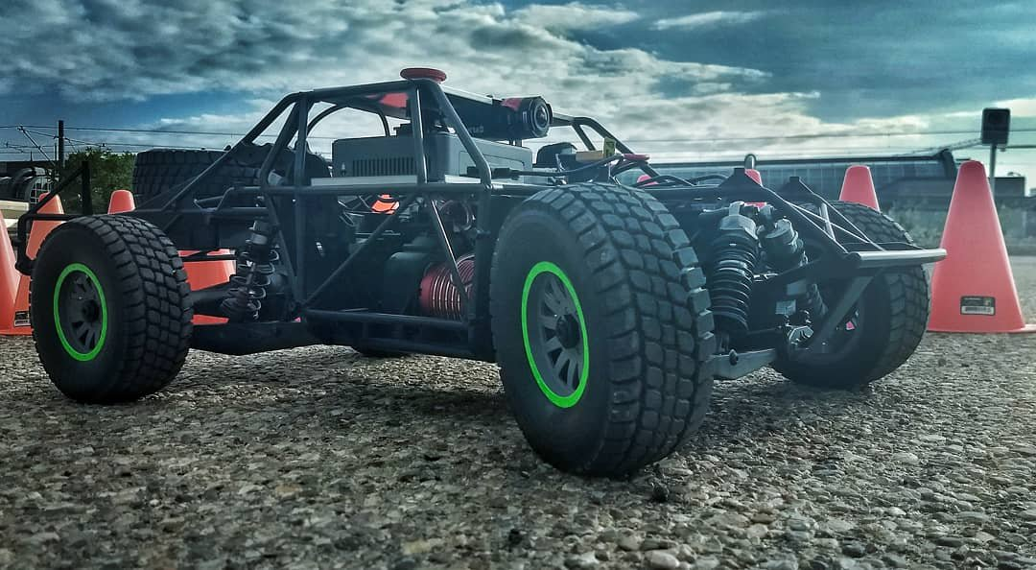
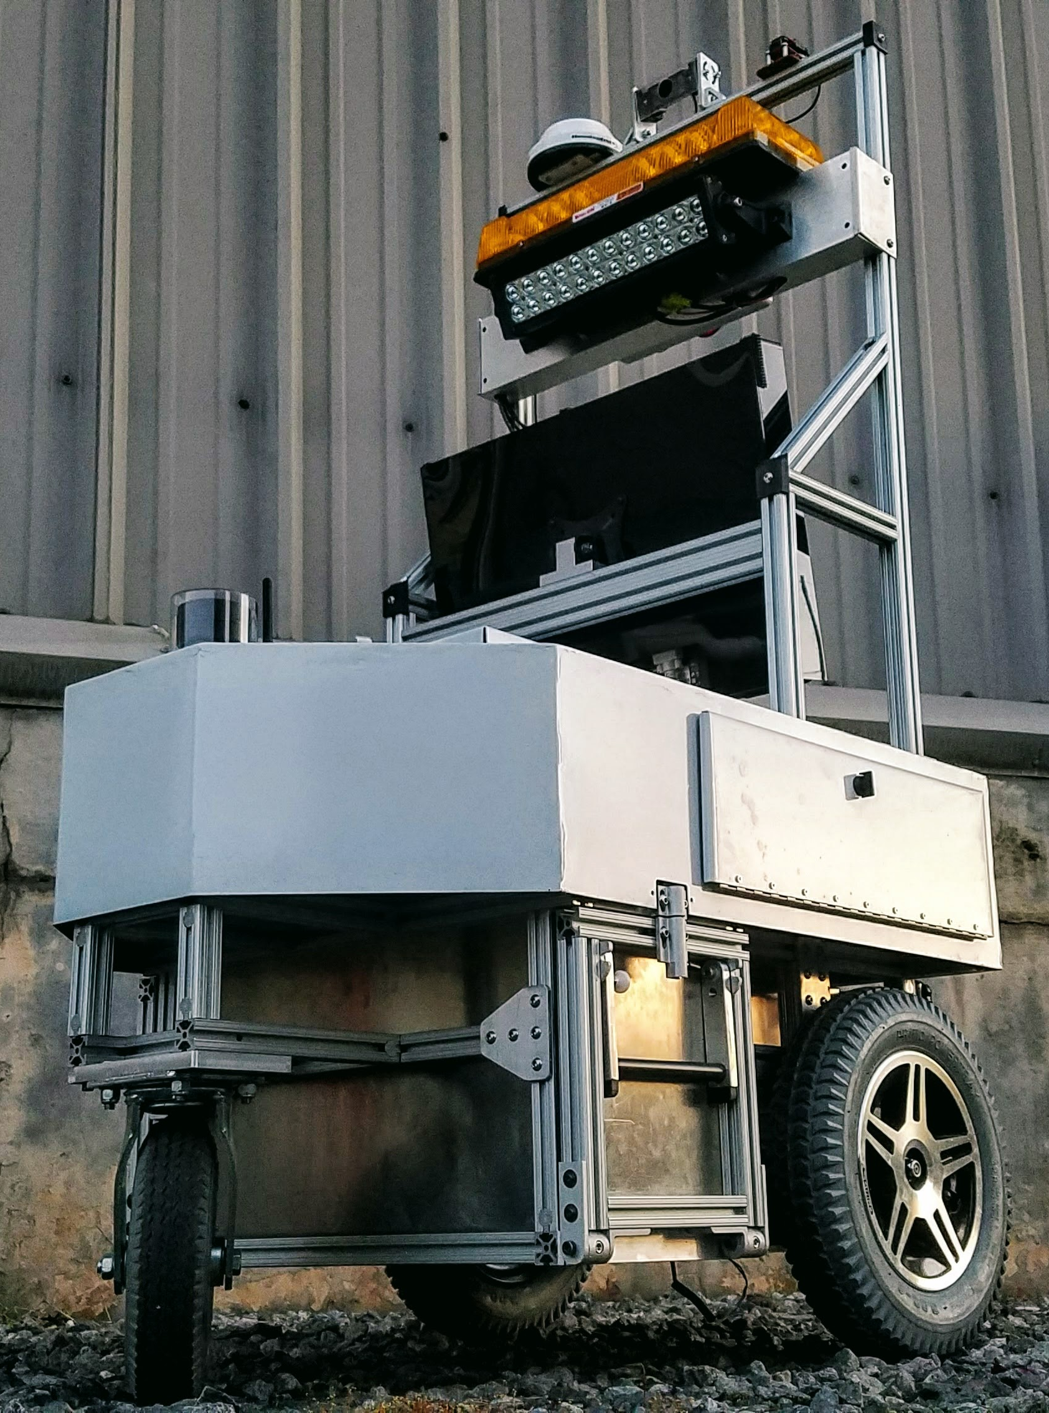
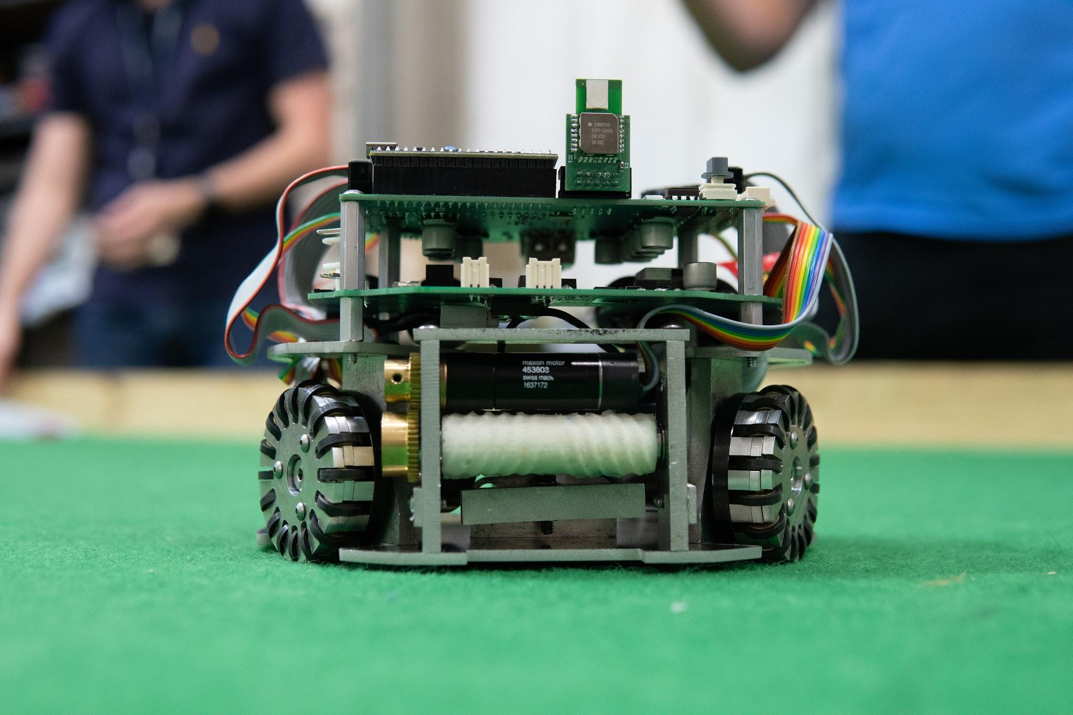
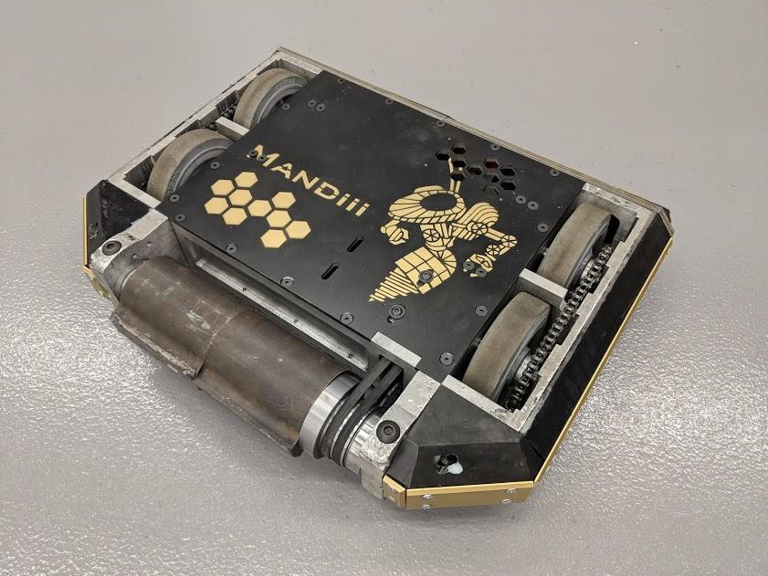

Slide 5
RoboJackets Electrical
Embedded System Design
Printed Circuit Board design
Analog and Digital Circuitry
Microcontroller firmware programming
Control systems
A bunch of other cool stuff!

Slide 6
Training Board Overview

Slide 7
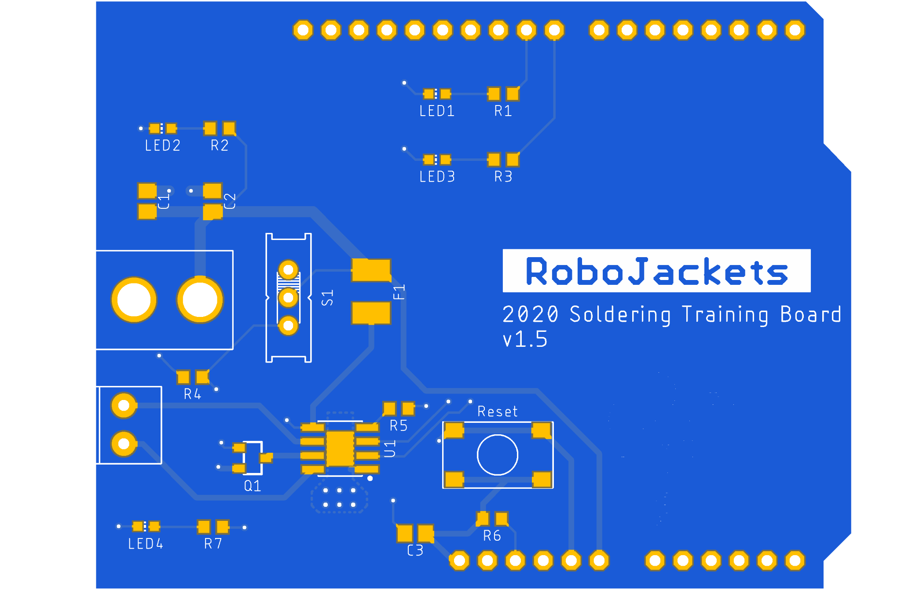
The Board

Slide 8
Purpose
Control a brushed DC motors using an Arduino Uno
Motor Driver chips controlled with logic/PWM signals from Arduino
Source power from 12V DC Barrel Jack

Slide 9
Components
DC Barrel Jack
Source power
Screw Terminal
To attach motor wires
Power Switch
Turn motor on or off
Fuse
Overcurrent protection

Slide 10
Components
Reset Button
Reboots Microcontroller
Motor Driver
Converts logic signals to motor power
Indication LEDs
Visually indicate power, fuse, and status of system

Slide 11
Soldering
I suppose this is what you actually came here for...

Slide 12
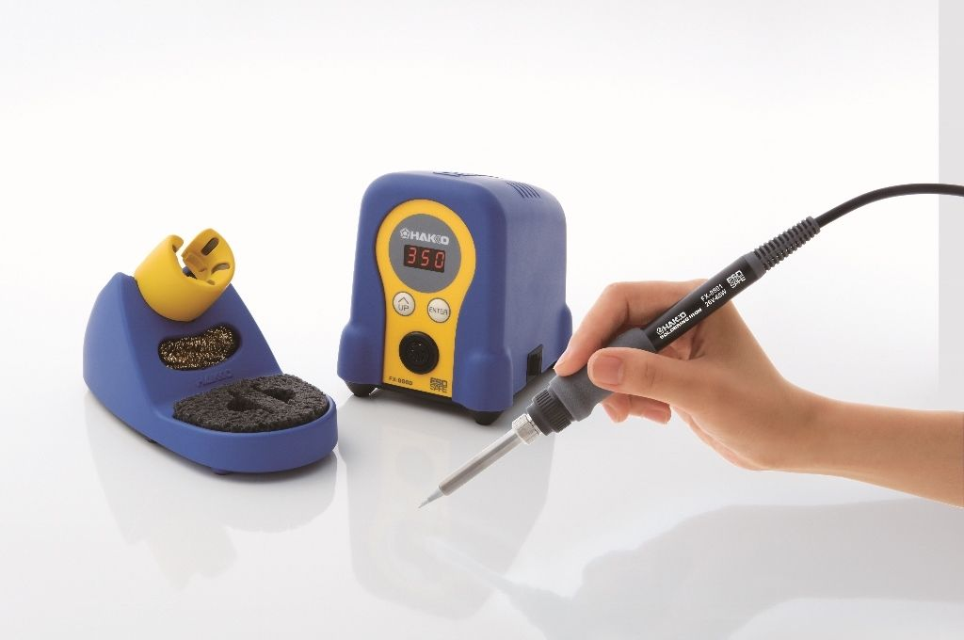
Safety
Hold like a pencil from plastic grip area
Entire metal gets hot (not just the tip!)
Make sure iron is in holder when not in use

Slide 13
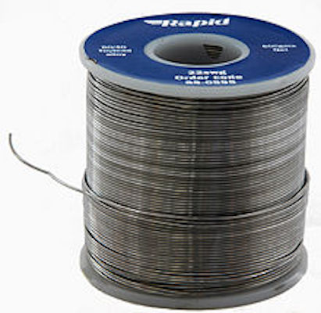
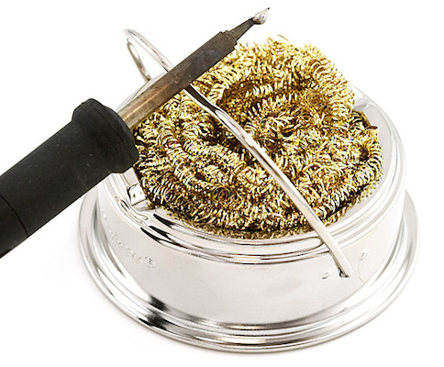
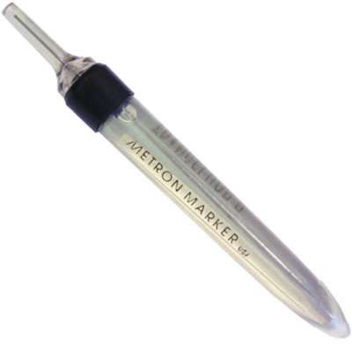
Supplies
Solder Metal that is melted to form joints
Solder Metal that is melted to form joints
Sponge For cleaning iron tip
Flux Helps solder to flow more easily

Slide 14
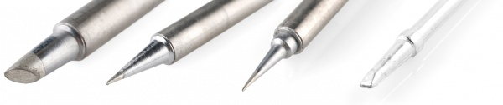
Supplies
Iron Tips - Choose based on desired precision and heat transfer capability

Slide 15
Supplies
Exhaust Fan
Keep solder fumes out of your lungs
Desoldering Wick
Copper mesh to remove solder
Desoldering Pump
Sucks out undesired solder

Slide 16
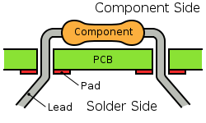
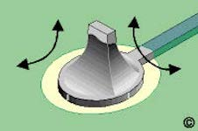
Through-Hole Soldering
Place pins in hole
Touch iron to both pin and pad simultaneously
Apply solder to pad at opposite side of iron
Remove solder, then iron, then clip excess

Slide 17
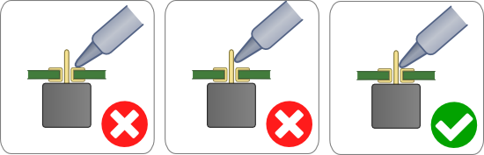
Heating Technique
Touch both the component and the pad at the same time
Make sure to apply solder to the pad, not the iron
Remove solder before removing iron

Slide 18
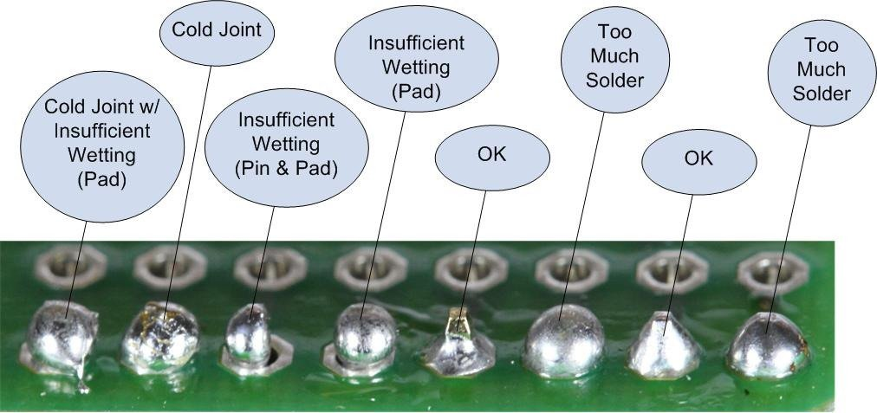
How much Solder?
Fully cover the pad, but don’t form a bubble

Slide 19
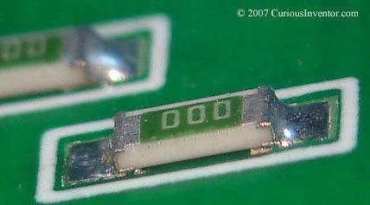
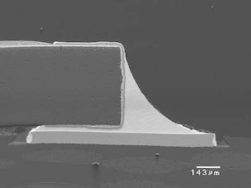
Surface Mount Components
Wet one pad with Solder
Place component on pad and remove iron
Solder remaining pads before reflowing first pad

Slide 20
Other Soldering Techniques/Tips

Slide 21
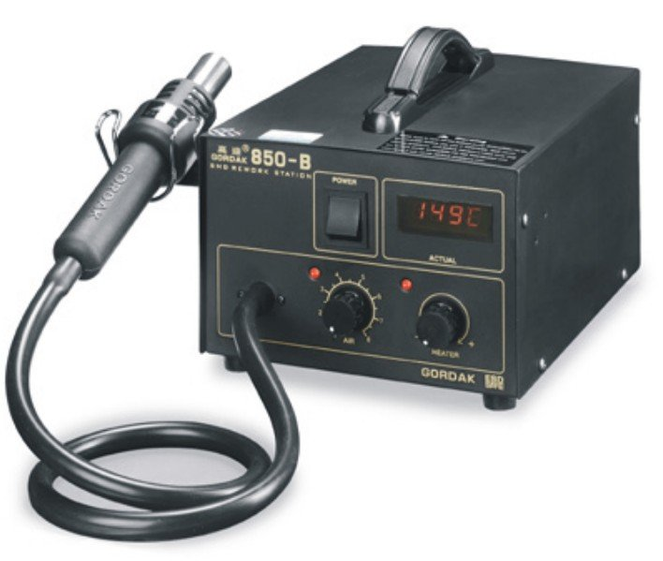
Hot Air Gun

Slide 22
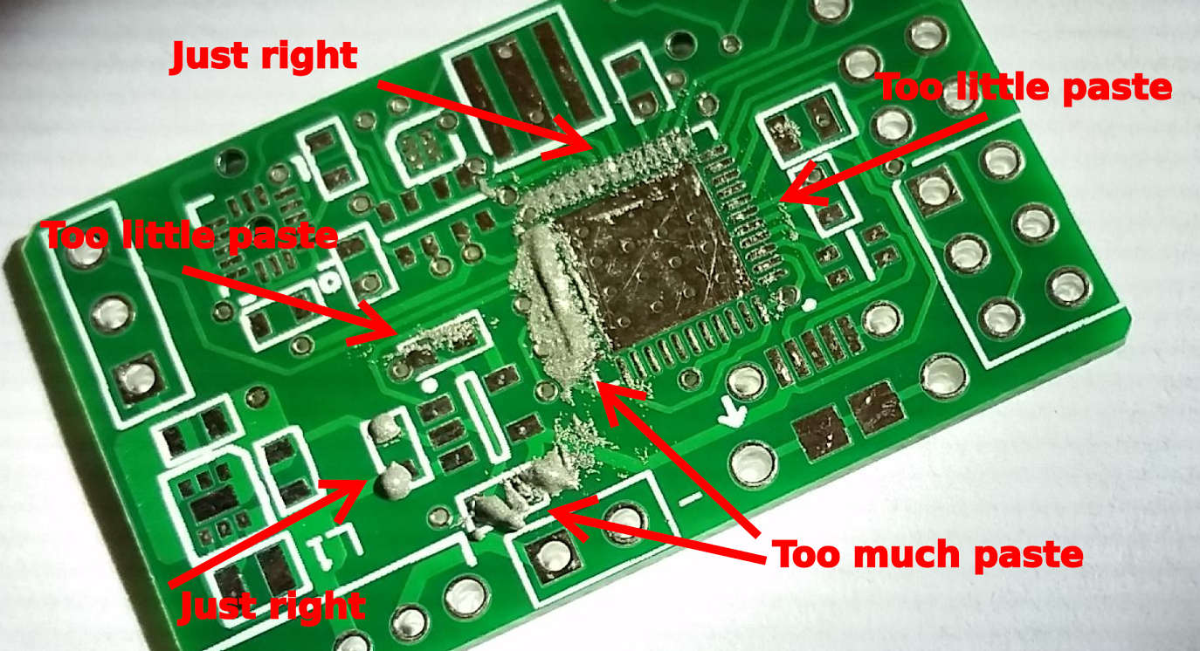
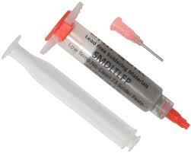
Solder Paste

Slide 23
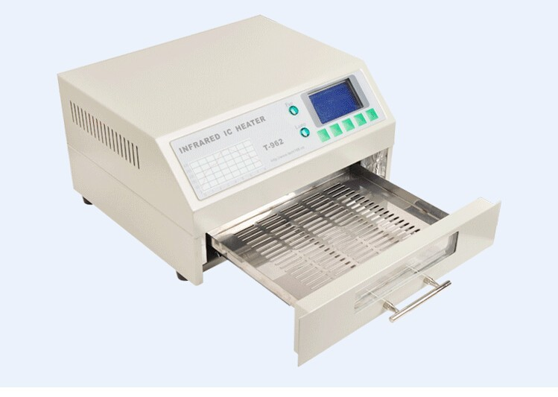
Reflow Oven

Slide 24
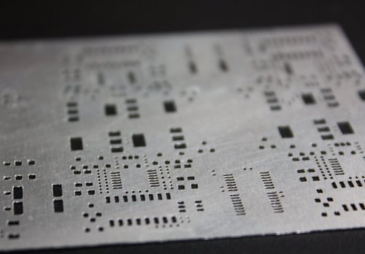
Soldering Stencil
Apply paste using stencil
Remove stencil and place all components
Place circuit board in reflow oven

Slide 25
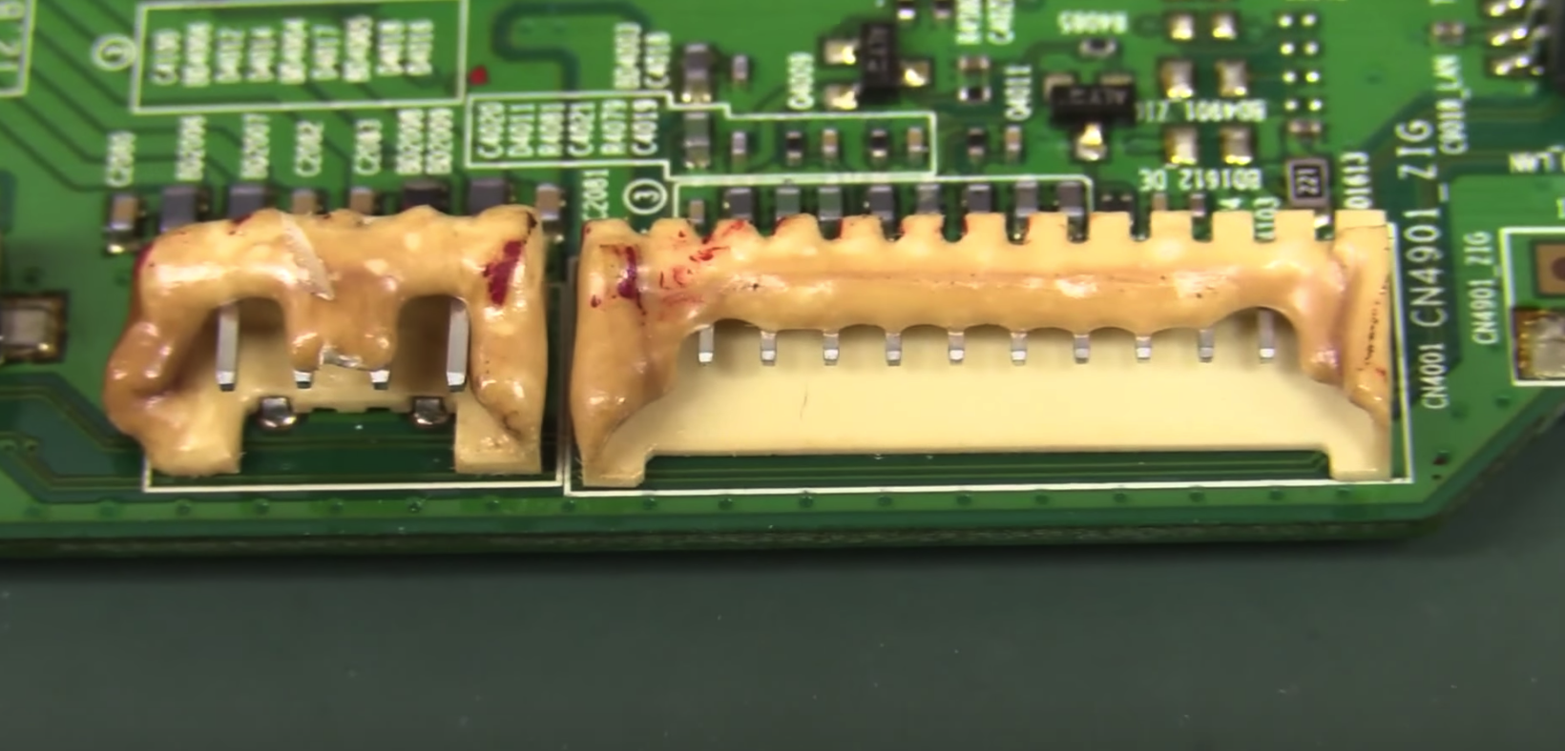
Tips
Previously mentioned techniques heat up entire circuit board
Some components cannot stand the heat
Make sure your components (especially connectors) can take the heat

Slide 26
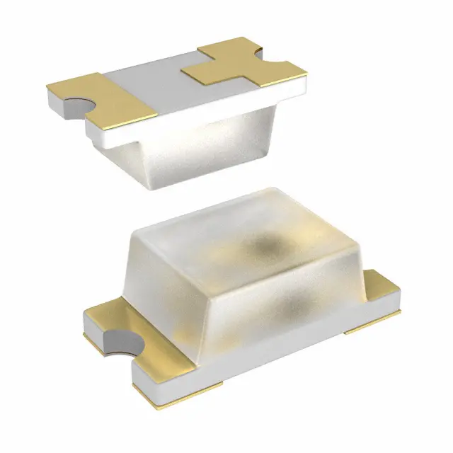
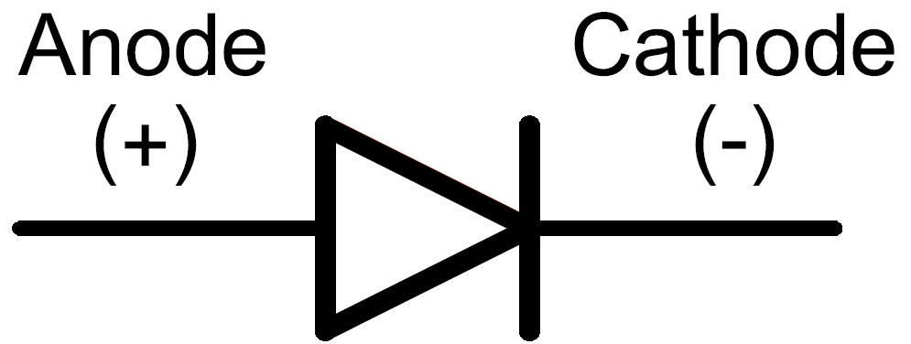
LED Direction
“Arrow points towards the house”
The “house” side is the cathode side which should be on the same side as the marking on the solder mask

Slide 27
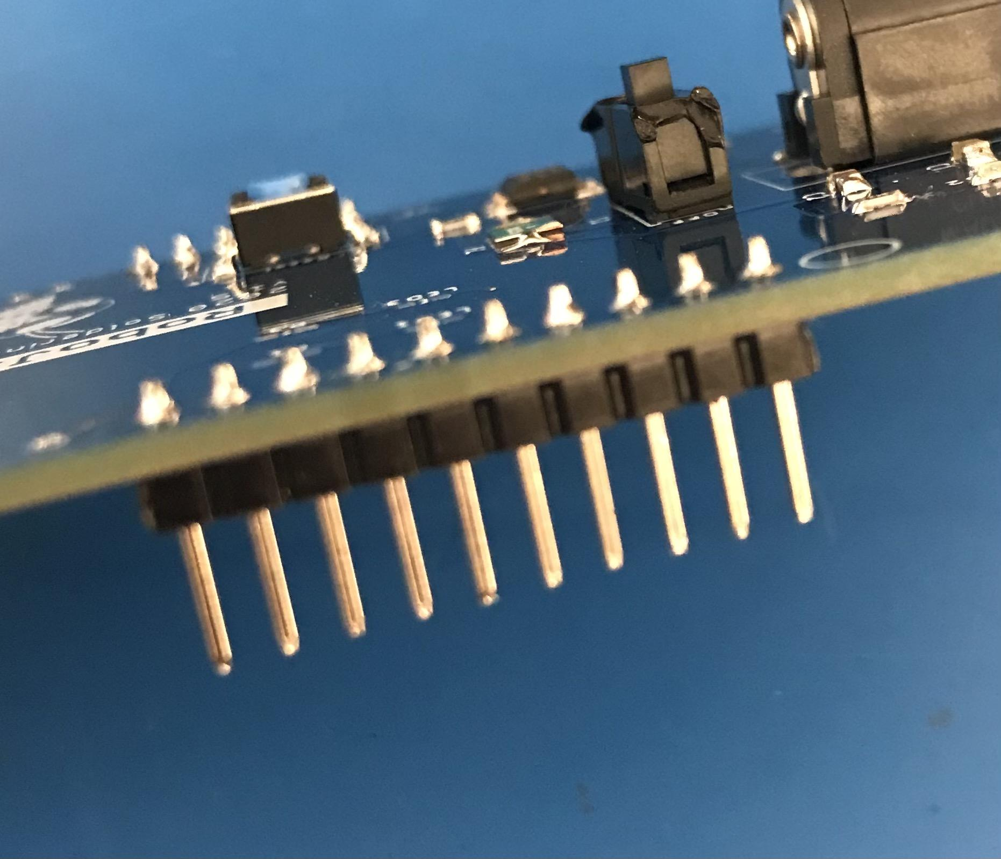
Pin Direction

Slide 28
Soldering Activity!
Solder the training board

Slide 29
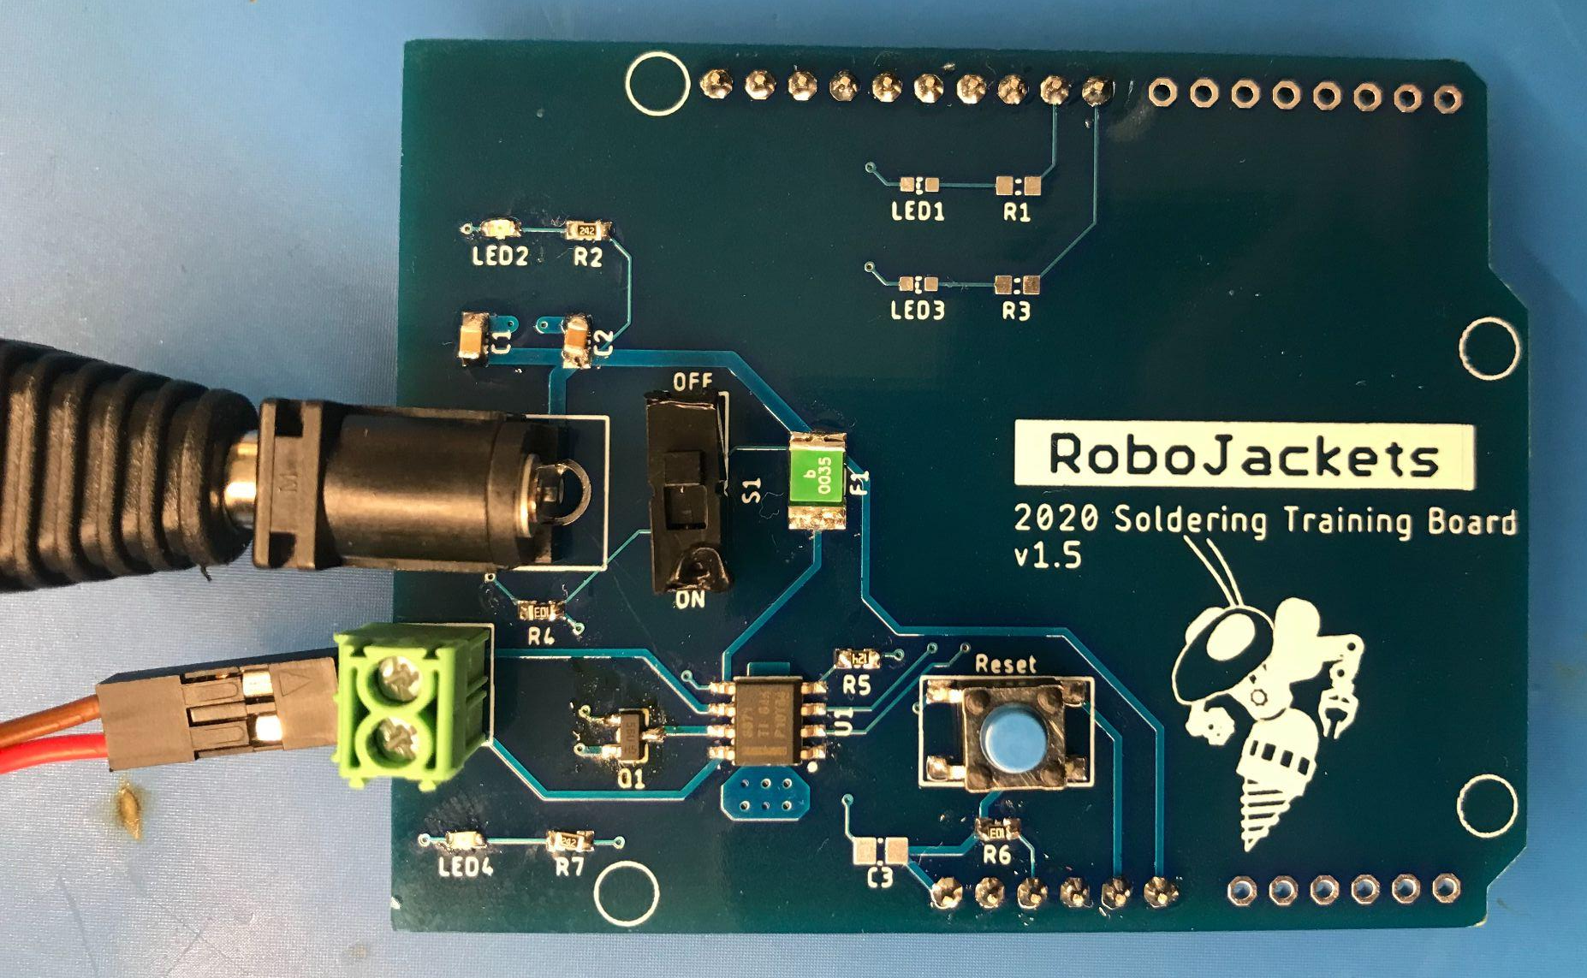
Sample Board

Slide 30
Debugging
Complex boards rarely work first time

Slide 31
Questions to Ask
What is the expected behavior?
What is the current behavior?

Slide 32
Getting Started
Top-Down Methodology

Slide 33
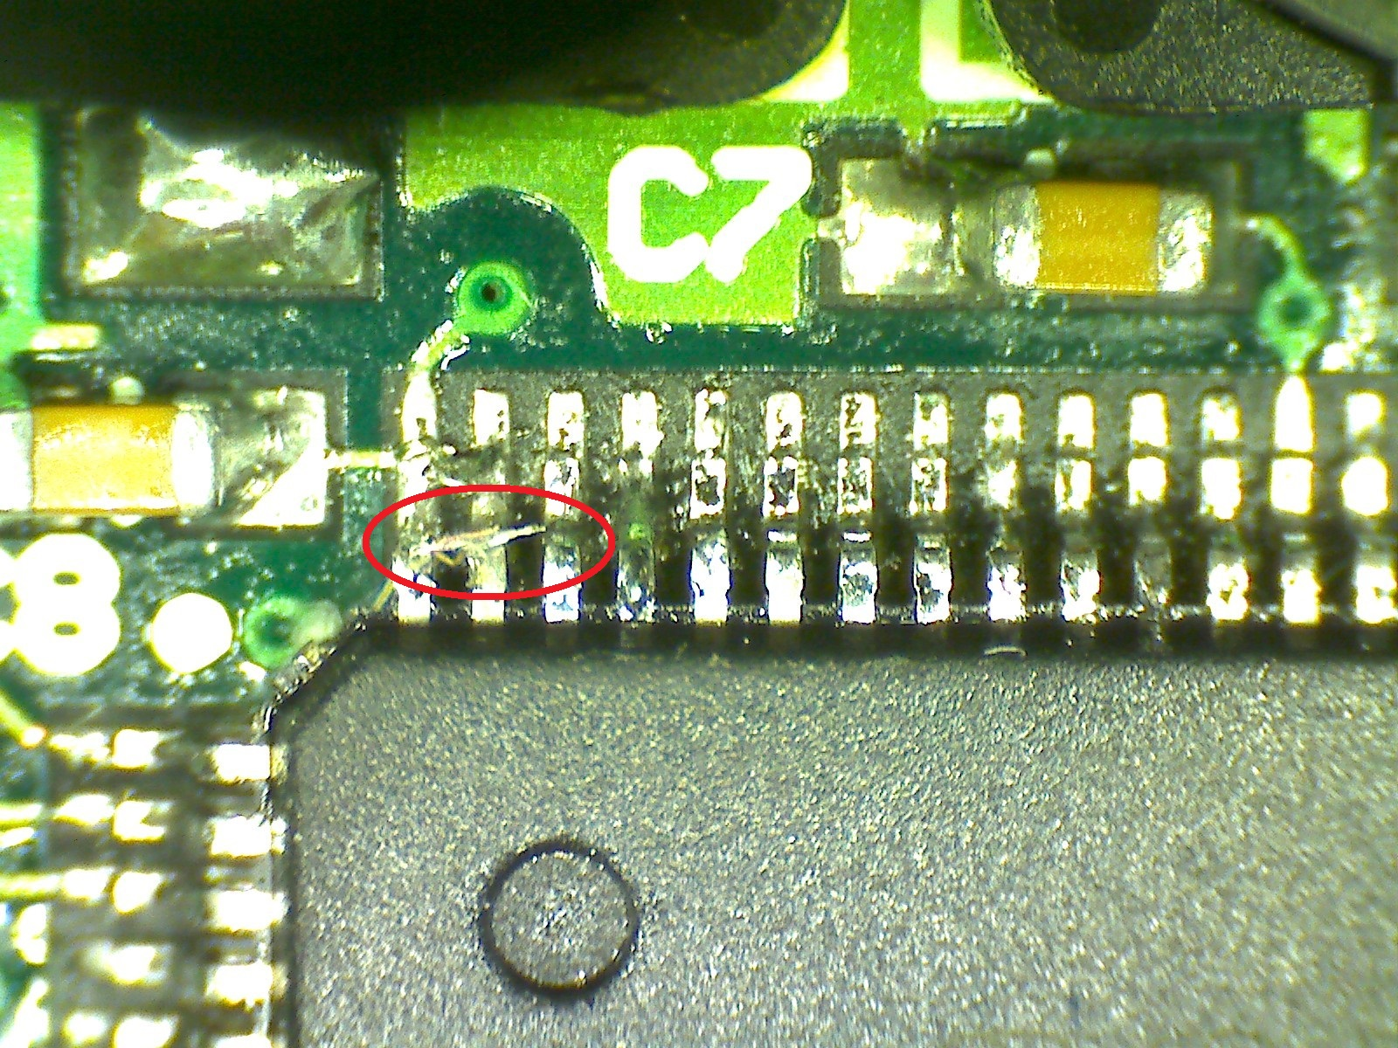
Done Soldering?
Always check for shorts!
Is there an oopsie?

Slide 34
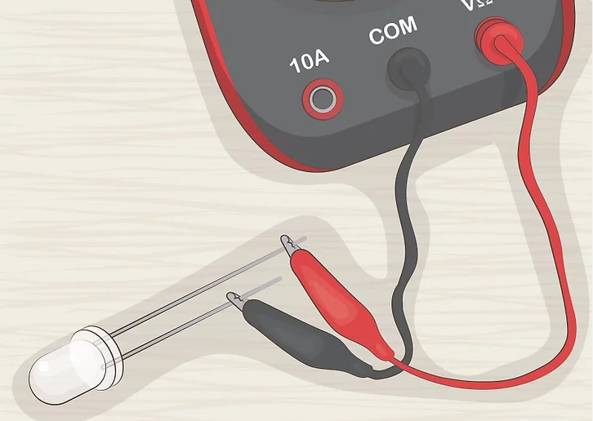
Is the power bus active?
But were they soldered correctly?
Continuity/Diode Mode
Power LEDs can save tons of time here

Slide 35
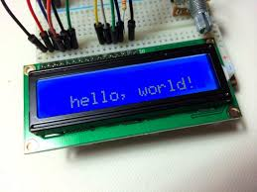
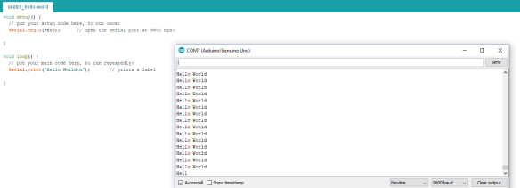
“Hello World”
Test basic code first

Slide 36
Every Circuit is Different
A few more pointers:
Data not being sent correctly?
Continuity between end points
Continuity to adjacent lines
Is firmware using the correct pins?
Could try reflowing the data lines or associated devices
Useful debugging tools
Multimeter
Voltage check
Continuity check
Oscilloscope
Can see waveforms over time
Useful to analyze noise issues
Many have decoding features
Isolate problems to transmitter or receiver ends
Always start general to not waste time

Slide 37
Debugging Activity
Sorry not sorry

